Slide 1
CIS 4930/6930-002 Data Visualization
Machine Learning & Data Mining
Paul Rosen
Assistant Professor
University of South Florida

Slide 2
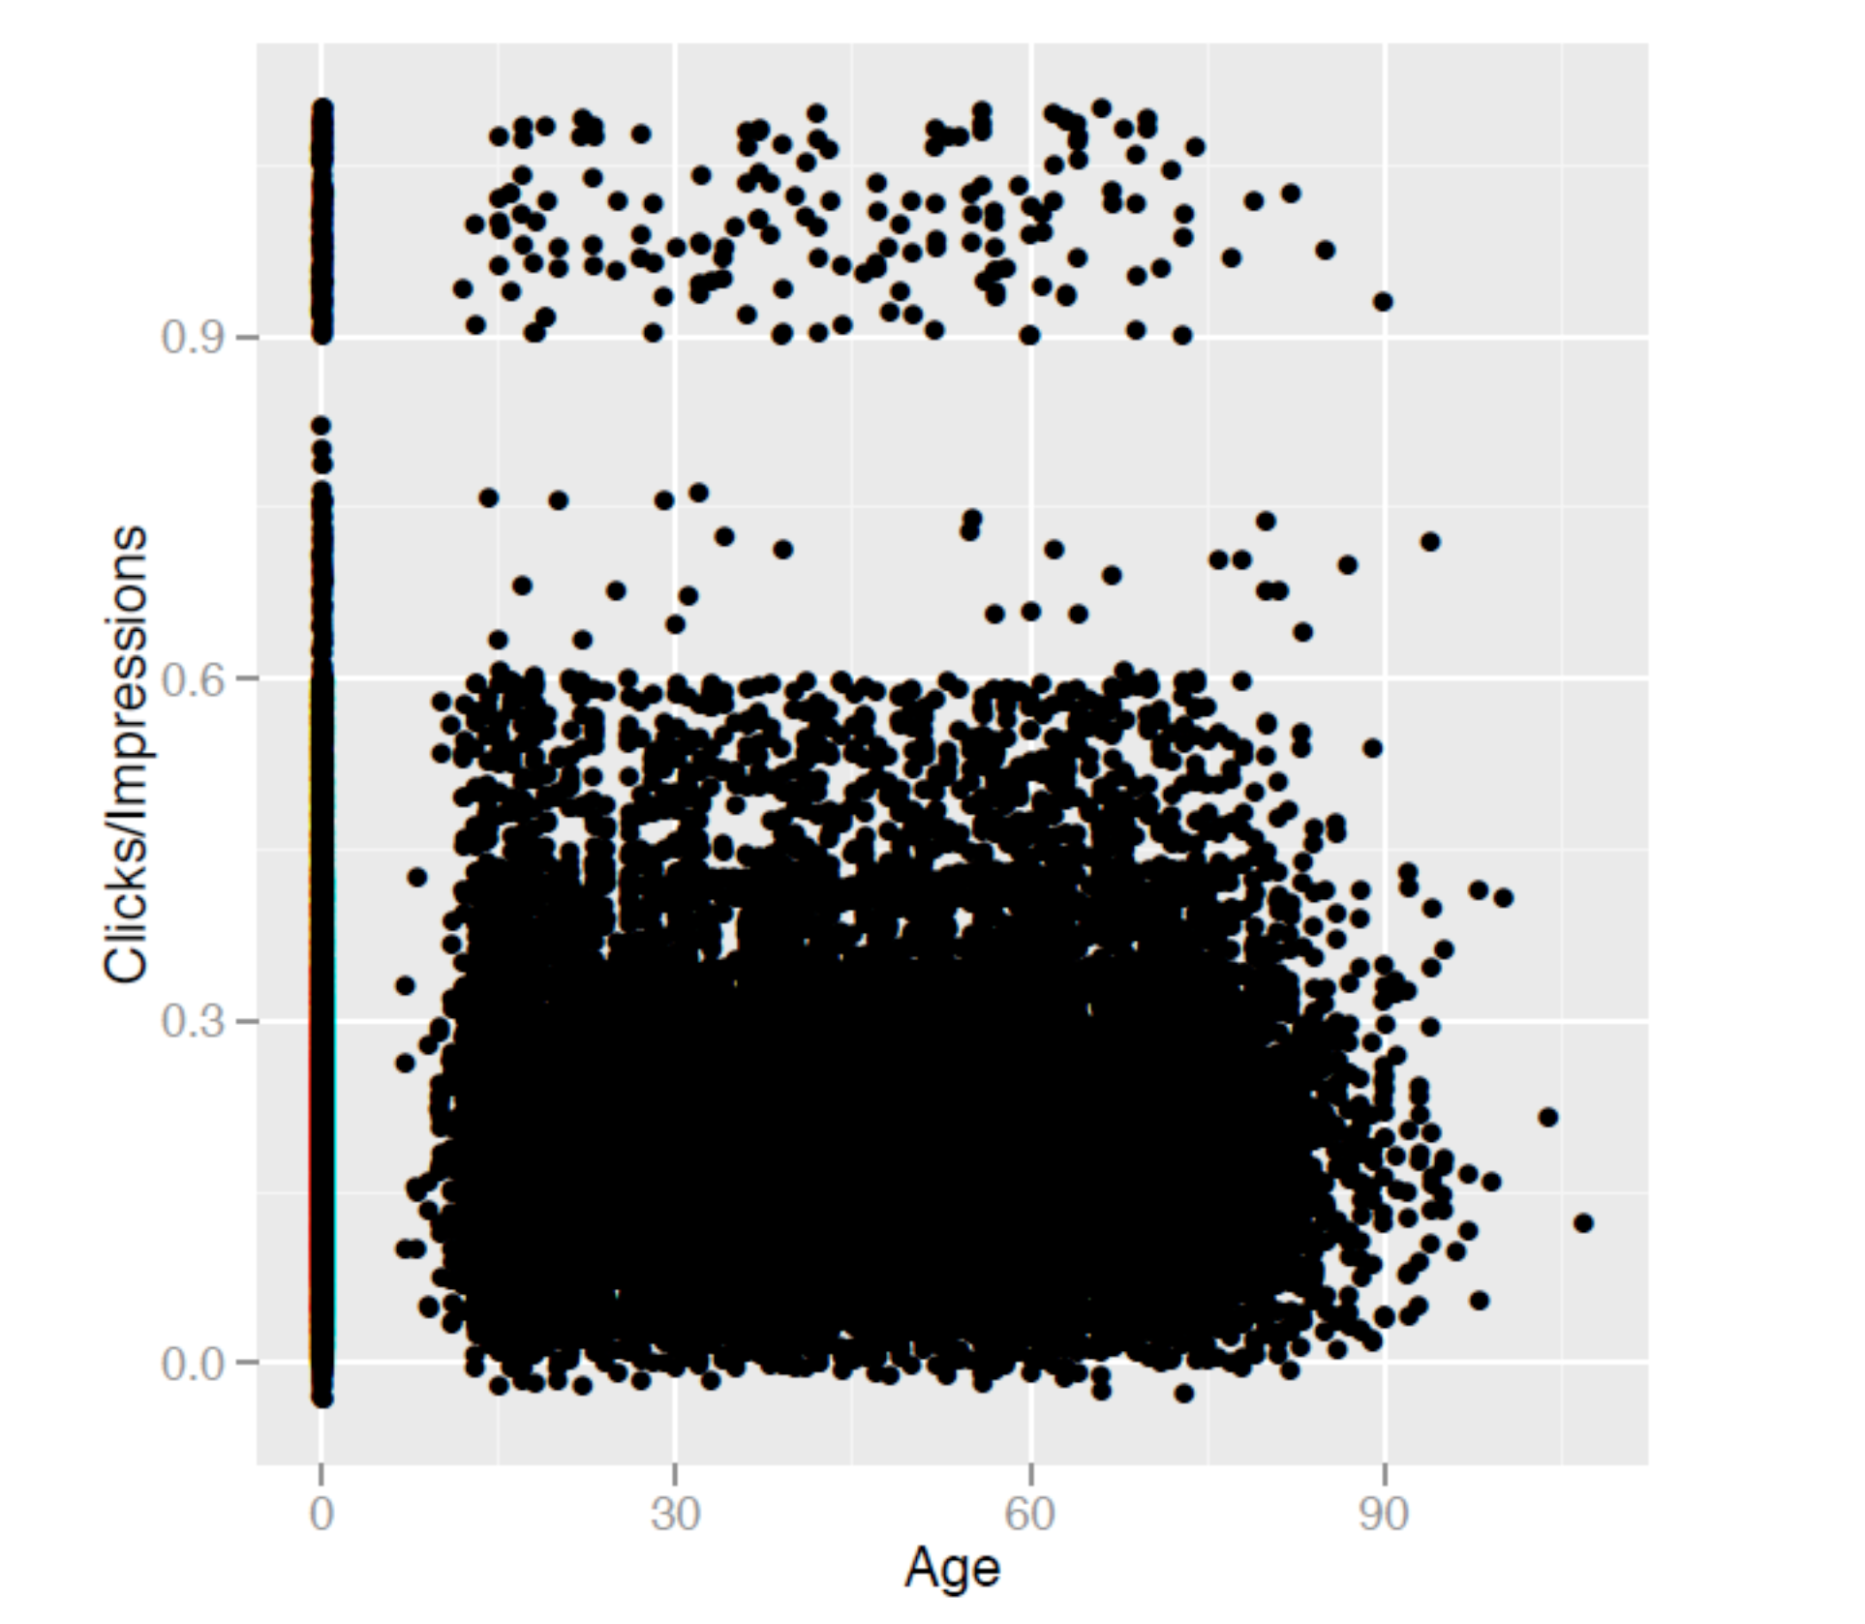
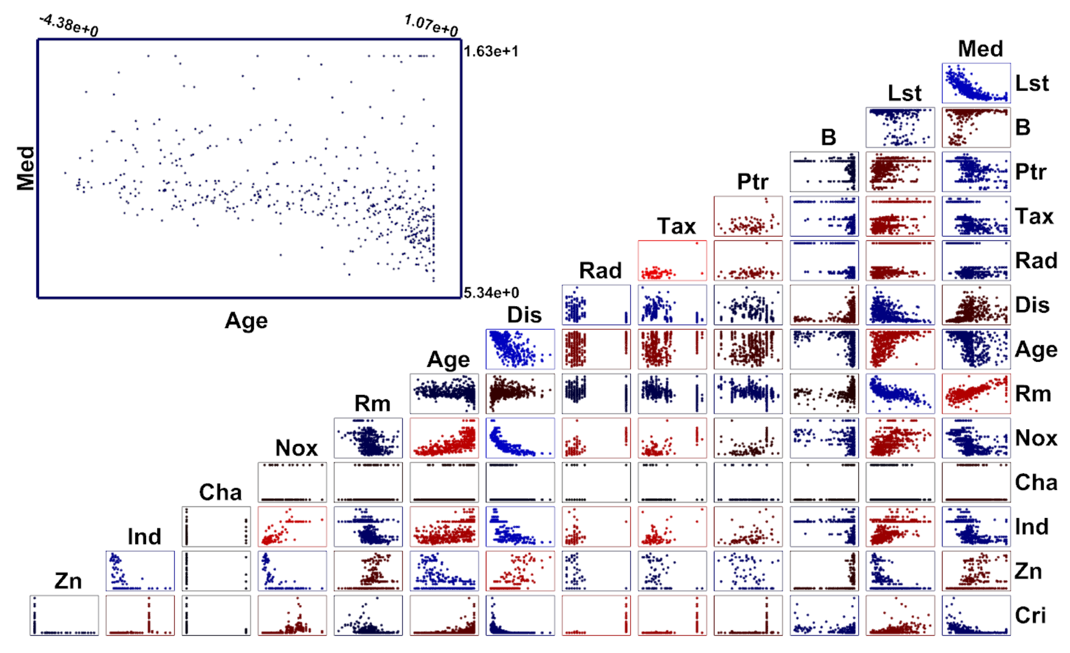
The problem
Number of data points and attributes are large
Limited human visual capacity

Slide 3
The solution
use the machine to do most of the work
But how?

Slide 4
Statistics
As we will see, statistics can help in a number of ways, but they don’t give you everything you need/want

Slide 5
Data Mining tools
Help to interpret data by (hopefully) reducing them to their core components/features

Slide 6
We’ll (briefly) talk about
Dimensionality Reduction
Classifiers
Regression
Clustering

Slide 7
Dimensionality Reduction
Comes in 2 basic flavors, linear and nonlinear

Slide 8
Linear Dimensionality reduction: Principal Component Analysis (PCA)
Given a set of data points embedded in any number of dimensions
Find the vector (direction) with the largest variance
Repeat for additional vectors, finding the next largest variance orthogonal to all previous principal components

Slide 9
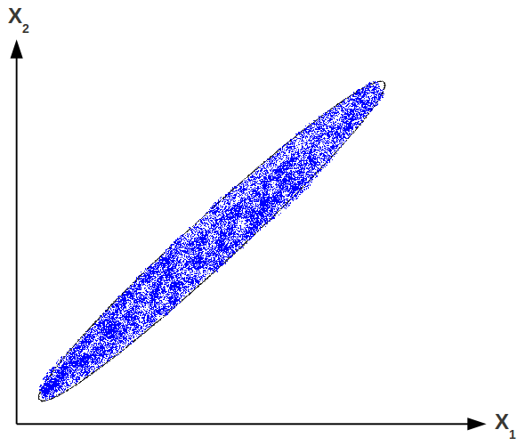
PCA: an example

Slide 10
PCA: an example
u1

Slide 11
PCA: an example
u1
u2

Slide 12
PCA Provides
A new basis that maximizes variance, where the length of the vectors indicates variance in that direction
Common practice is to reproject points by subtracting the mean and adjusting basis

Slide 13
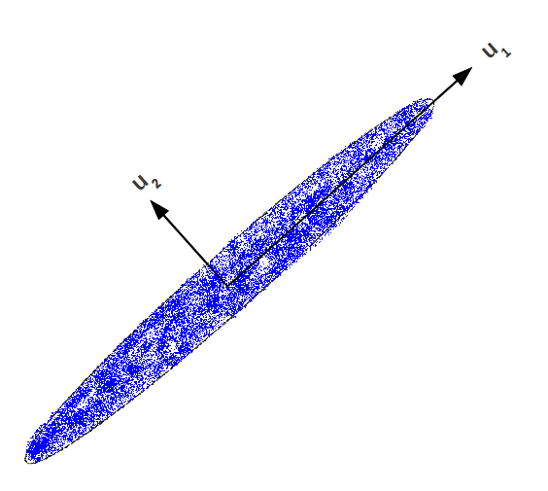
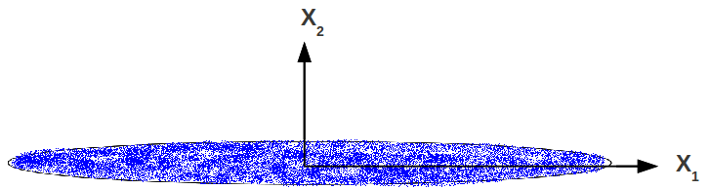
PCA: an example

Slide 14
PCA Provides
If data is higher than 2D, the first 2 principal components can be selected (or 3 for 3D)

Slide 15
What do we gain/lose…
when is this a good/bad idea…
In the 2D case?
In an nD case?

Slide 16
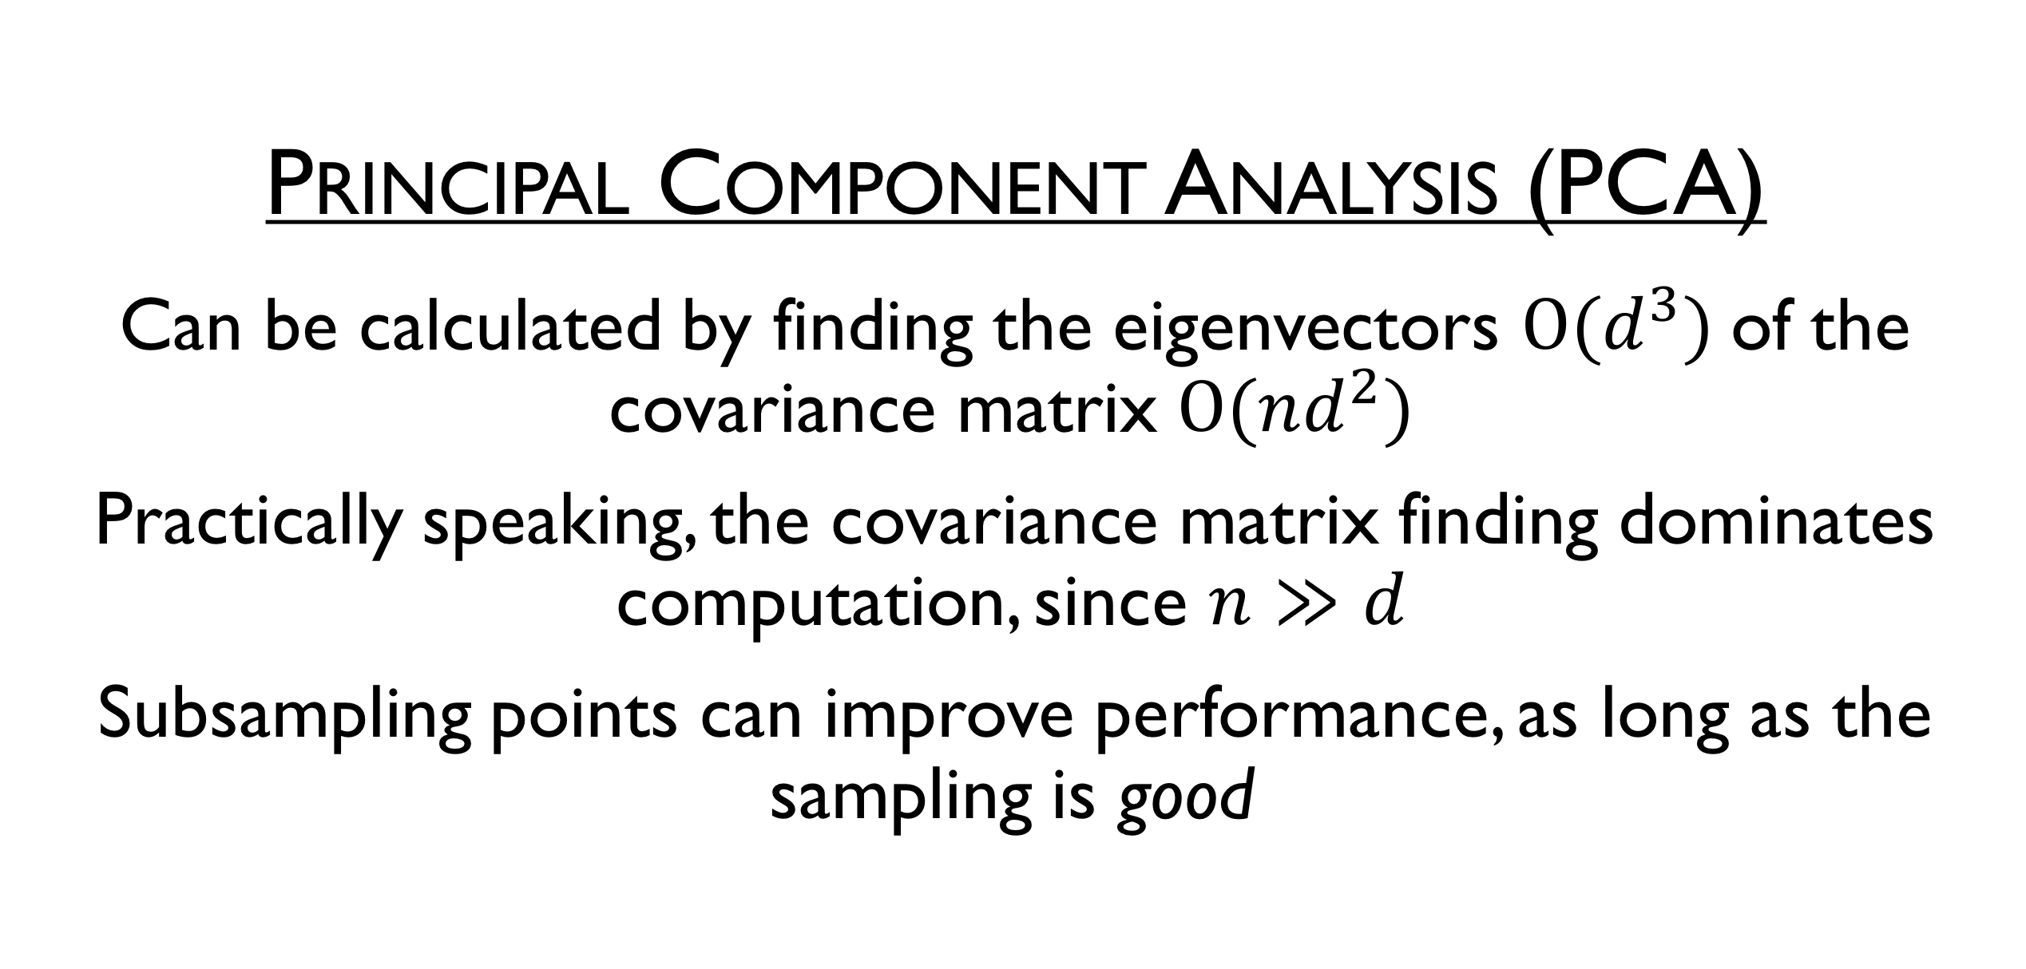
Principal Component Analysis (PCA)
Can be calculated by finding the eigenvectors $Ο(d^{3})$of the covariance matrix $Ο(nd^{2})$
Practically speaking, the covariance matrix finding dominates computation, since $n≫d$
Subsampling points can improve performance, as long as the sampling is good

Slide 17
Nonlinear Dimensionality Reduction: Multidimensional Scaling (MDS)
Given pairwise distances/dissimilarities
Find a map that preserves distances

Slide 18
MDS
Many “flavors”
We’ll look at classical MDS

Slide 19
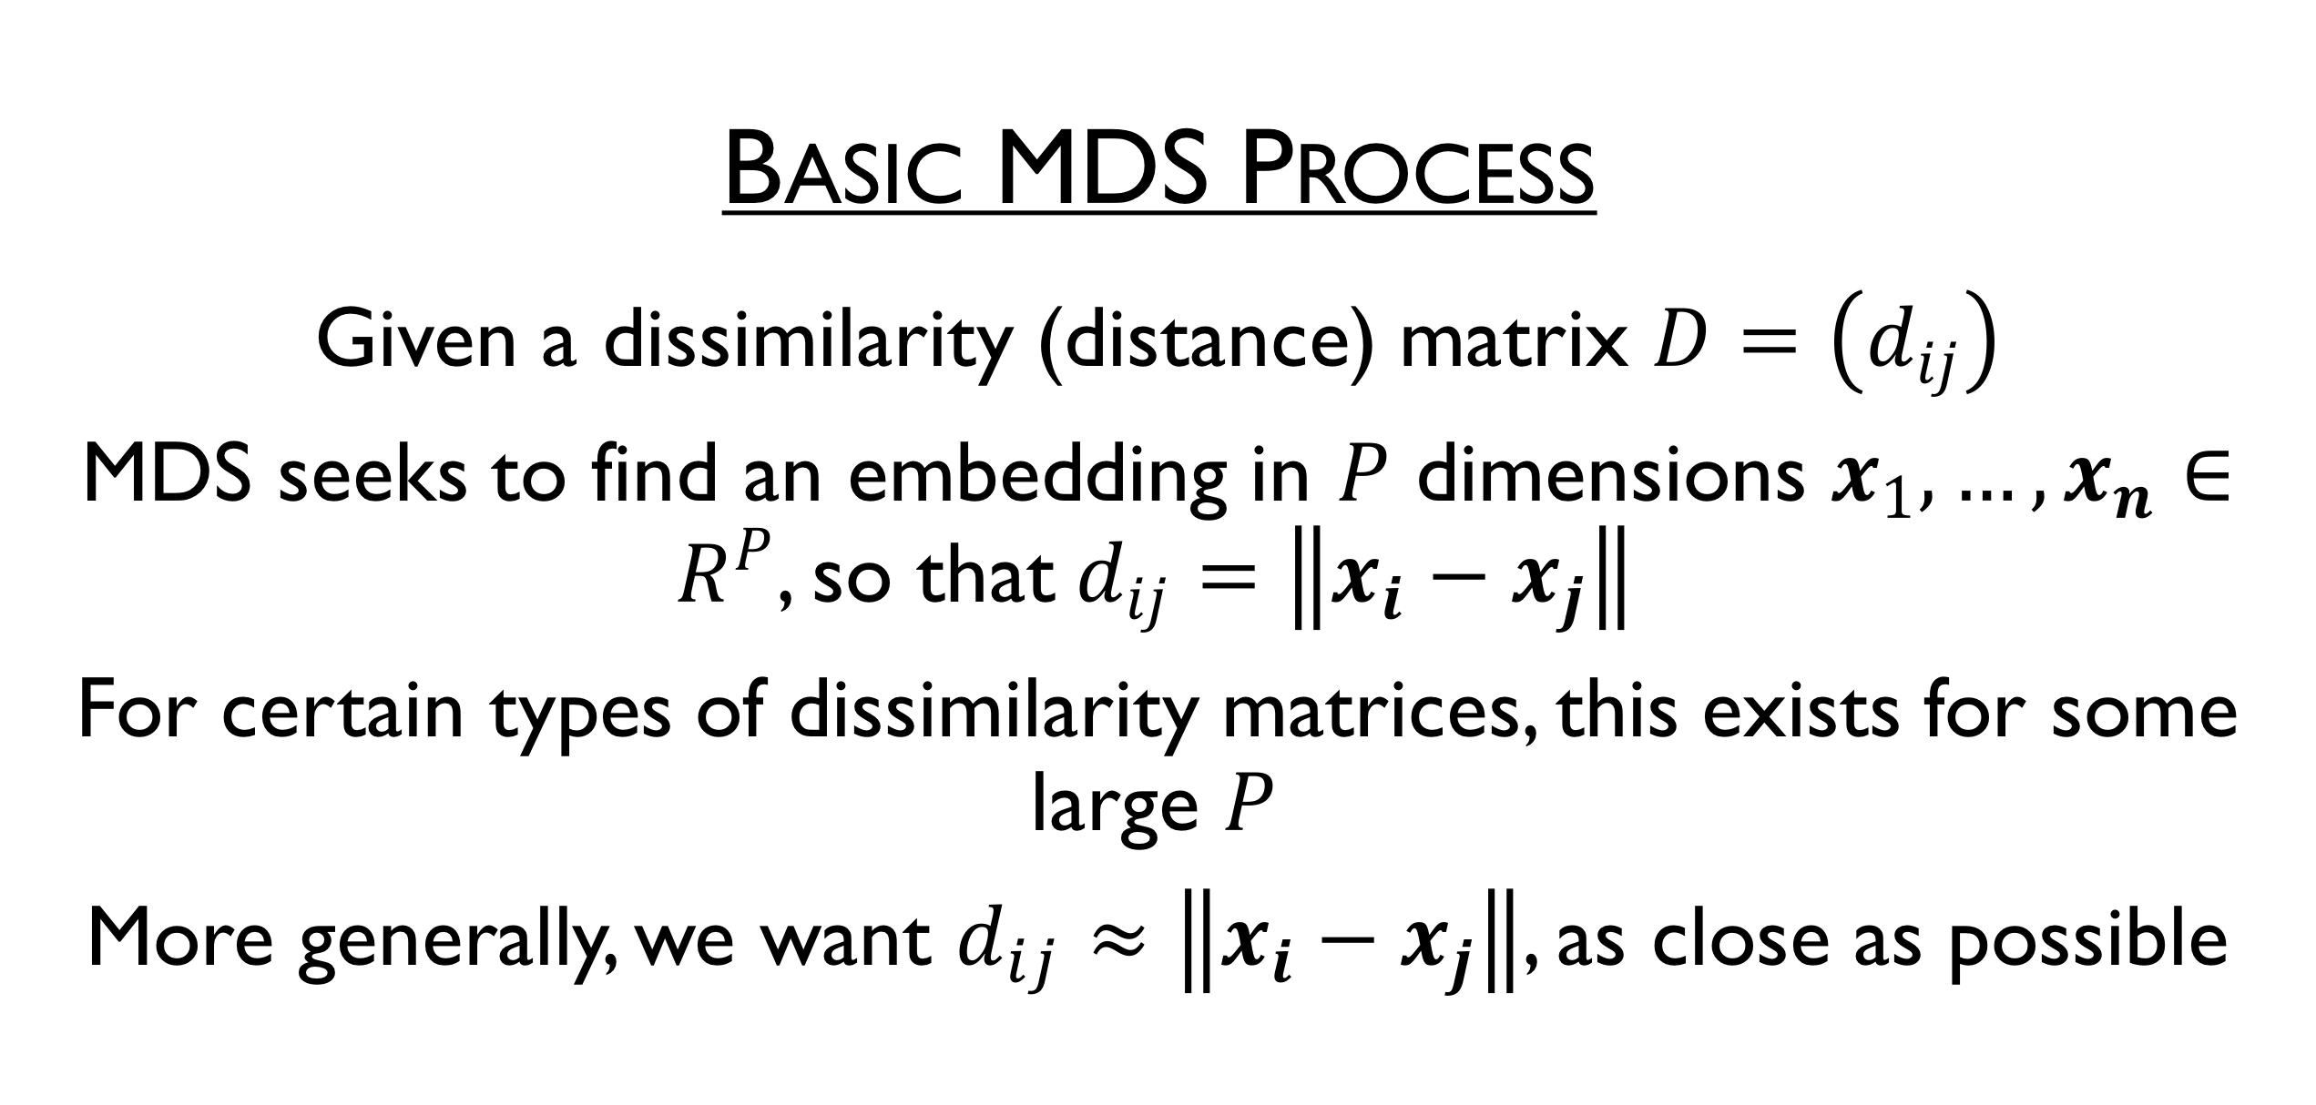
Basic MDS Process
Given a dissimilarity (distance) matrix $D=\left(d_{ij}\right)$
MDS seeks to find an embedding in $P$ dimensions $x_{1},…, x_{n}∈R^{P}$, so that$d_{ij}=\left\|x_{i}−x_{j}\right\|$
For certain types of dissimilarity matrices, this exists for some large $P$
More generally, we want $d_{ij}≈\left\|x_{i}−x_{j}\right\|$, as close as possible

Slide 20
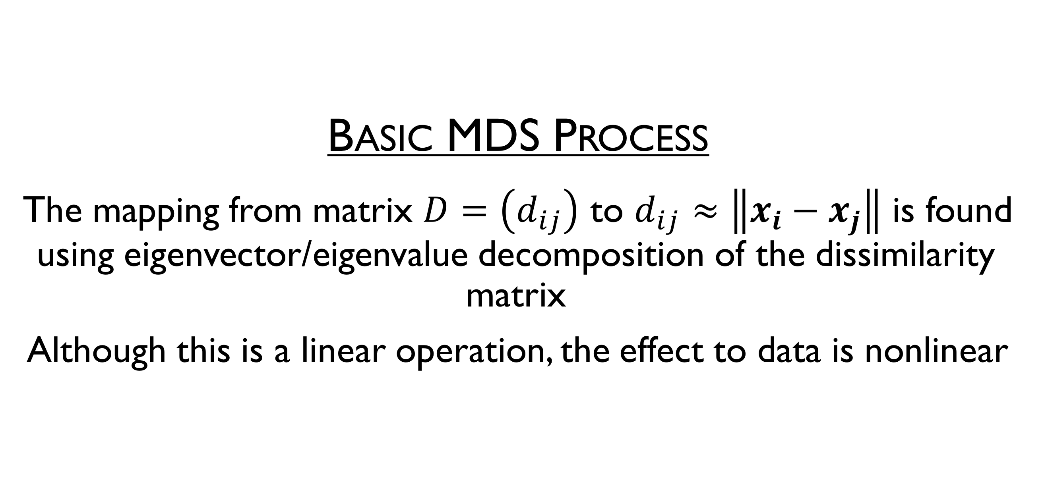
Basic MDS Process
The mapping from matrix $D=\left(d_{ij}\right)$ to $d_{ij}≈\left\|x_{i}−x_{j}\right\|$ is found using eigenvector/eigenvalue decomposition of the dissimilarity matrix
Although this is a linear operation, the effect to data is nonlinear

Slide 21
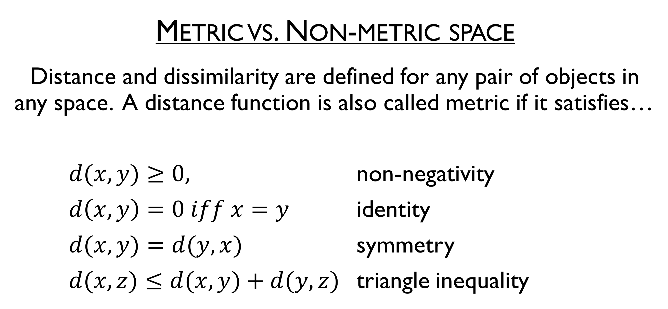
Metric vs. Non-metric space
Distance and dissimilarity are defined for any pair of objects in any space. A distance function is also called metric if it satisfies…
$d(x, y)≥0,$ non-negativity
$d\left(x, y\right)=0 iff x=y$ identity
$d(x, y)=d(y, x)$ symmetry
$d(x, z)≤d(x, y)+d(y, z)$ triangle inequality

Slide 22
Metric vs. Non-metric space
Given a set of dissimilarities, one can ask whether these values are distances, and whether the space they define is metric or not
Why does this matter?
Non-metric data requires special treatment

Slide 23
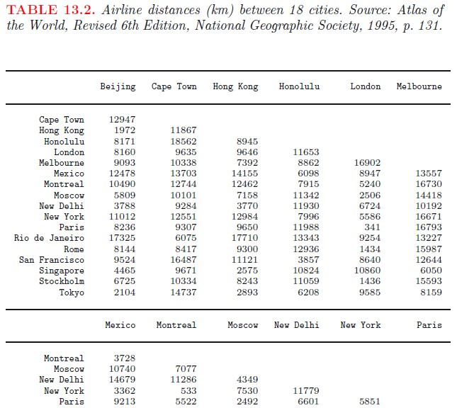
Classical MDS example: Airline distances

Slide 24
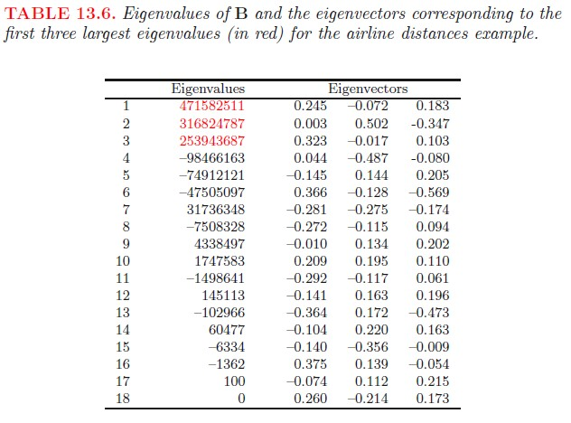
Classical MDS example: Airline distances
Negative eigenvalues indicate Airline distance is non-metric
Should only use at most first 3 eigenvectors (negative eigenvalues produce resulting in the imaginary domain)
21 / 41

Slide 25
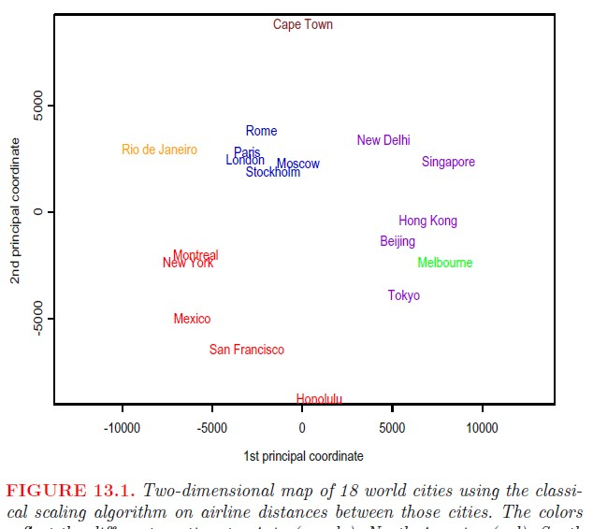
Classical MDS example: Airline distances

Slide 26
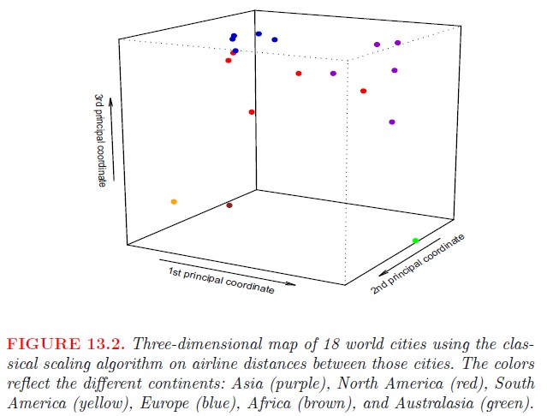
Classical MDS example: Airline distances

Slide 27
Classical MDS example: Airline distances

Slide 28
Nonlinear Dimension Reduction
A lot of options, all preserve different features of the high dimensional space

Slide 29
Multidimensional Scaling (MDS)
We’ve already seen

Slide 30
Local Linear Embedding (LLE)
Tries to embed such that local neighborhood distances are preserved as well as possible

Slide 31
LLE Extensions
Fix various issues associated with regularization of the domain in LLE

Slide 32
Local Tangent Space Alignment (LTSA)
Tries to characterize geometry via local tangent directions

Slide 33
Isomap
Extension of MDS. Tries to preserve geodesic distance as well as possible

Slide 34
Spectral Embedding
Uses a spectral decomposition of the graph Laplacian

Slide 35
t-distributed Stochastic Neighbor Embedding (t-SNE)
Converts the points probability distribution and samples that distribution

Slide 36
So…Visualizing data, what do you use and when?

